Slide 1
RLQ: linking patterns in phylogeny, traits, environment and space
L2 StatisticsCorner
Ants Kaasik

Slide 2
My aim
You know what RLQ is, what steps are carried out during the analysis and what the end-product is
You know that it is possible to do this analysis in R

Slide 3
Ordination?
RLQ is mostly and ordination technique
"Ordination is the collective term for multivariate techniques that arrange sites along axes on the basis of data on species composition" (ter Braak 1987)
" The displaying of a swarm of data points in a two or threedimensional coordinate frame so as to make the relationships among the points in many-dimensional space visible on inspection" (Pielou 1984)
Palmer M (2017). Ordination Methods for Ecologists (http://ordination.okstate.edu), visited 13.01.2022
Notes:
Basically, look our data with new coordinates but so that this visual is somehow informative

Slide 4
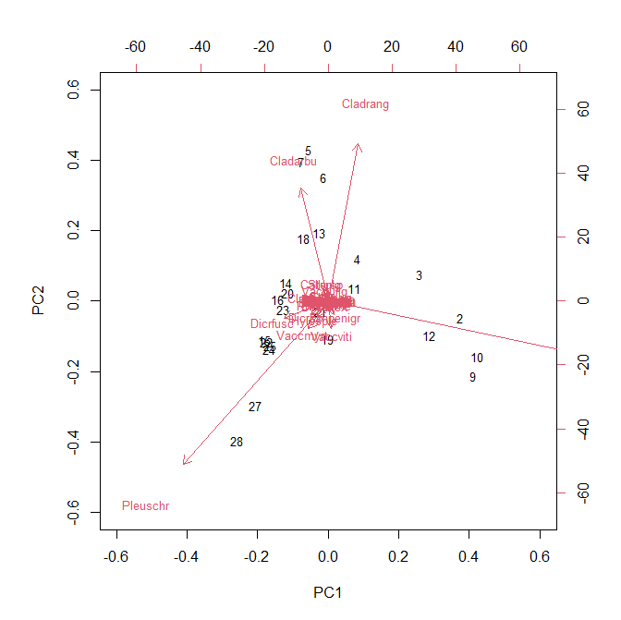
One simple ordination
Väre, H., Ohtonen, R. and Oksanen, J. (1995) Effects of reindeer grazing on understorey vegetation in dry Pinus sylvestris forests. Journal of Vegetation Science 6, 523–530.
Notes:
PCA, of the varespec dataset (from package vegan). Sites x Species dataset with coverage % as the measured variable. Species as arrows and sites as numbers

Slide 5
Missing fourth corner
It the classic setting we have
Sites x environment (R)
Sites x species (abundance or presence) (L)
Species x traits (Q)
and the object of interest is the relationship between environment and traits
i.e. we want an ordination that allows simultaneous map of environment and traits
Notes:
So we know how to produce ordination for 1) and 2) and 3) separately but what about a simultaneous ordination?
BTW The term duality diagram is also often used (this again notes that there are two things on the same ordination (e.g. sites and species)

Slide 6
RLQ and fourth corner test
RLQ ordination is the solution – we produce (typically) one or two axes (in some meaningful way) and can represent the traits and environment in these new coordinates
Fourth corner test is a formal (permutation based) testing procedure for evaluating the significance of the patterns visible from the ordination
Notes:
E.g. we can test the association of one trait with one environmental variable or do a global test (of any relationship at all)

Slide 7
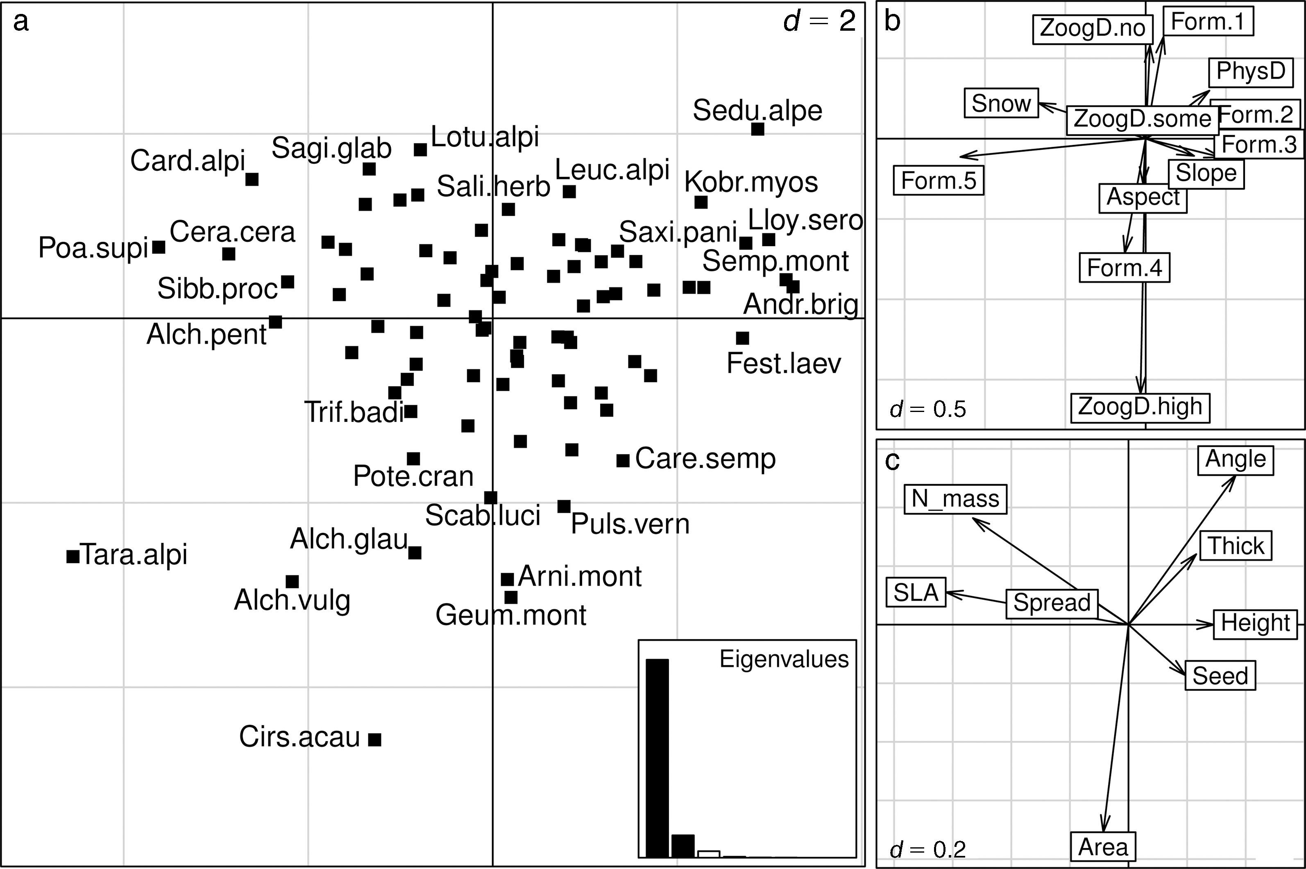
RLQ ordination example
Dray, S., Choler, P., Dolédec, S., Peres-Neto, P. R., Thuiller, W., Pavoine, S., & ter Braak, C. J. (2014). Combining the fourth‐corner and the RLQ methods for assessing trait responses to environmental variation. Ecology, 95(1), 14-21.
Notes:
a) species, b) environmental variables, c) traits (all in the same coordinates), typically the length of the arrow is proportional to the correlation between the variable and the ordination

Slide 8
RLQ step 1
3 separate ordinations: one for R, one for L, one for Q
Ordination technique depends on the variables present. E.g. if R contains only continuous variables then R is ordinated with PCA, if Q contains only categorical variables then Q is ordinated with MCA etc
Weights for the ordinations of R and Q are deduced from L
Notes:
There are many different ordination techniques but the underlying idea is always the same – allow „best“ representation of the main patterns present in the data using a few axes.
When we have very different variable types then we can still come up with a distance matrix and principal coordinates analysis can be used for ordinating that
Weighing is necessary because we want higher weights for species that are more abundant (in Q) and higher weights for sites that have more species (in R)

Slide 9
RLQ step 1 (cont.)
We must ordinate L so that species and sites are „aligned“
CA gives us a first axis so that the species scores and site scores have maximal possible correlation (given the data)
So (as the name says) ordination of L is such that there is correspondence between sites and species
Notes:
Maximal possible correlation but of course we use weights (high abundance points (site x species combination) must get large weights)
The other axes are similar with the exception that they have to be uncorrelated to each other.

Slide 10
RLQ step 1 example
Bumblebee abundance dataset: 40 sites and 17 species
Abundance is low – 10.6 specimens per site (on average), 4.2 species per site (on average)
Notes:
Remove sites with zero abundances, 37 remain

Slide 11
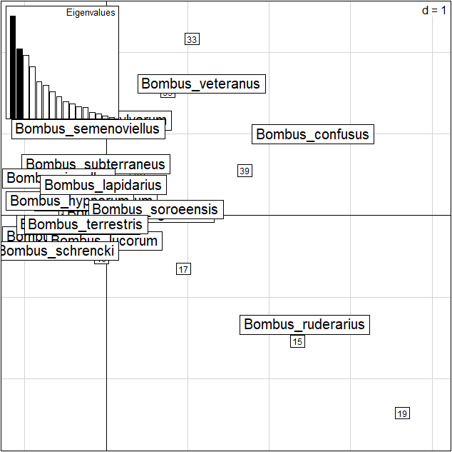
RLQ step 1 example (cont.)
Notes:
Eigenvalues decrease slowly (i.e. there isn’t very good correspondence).

Slide 12
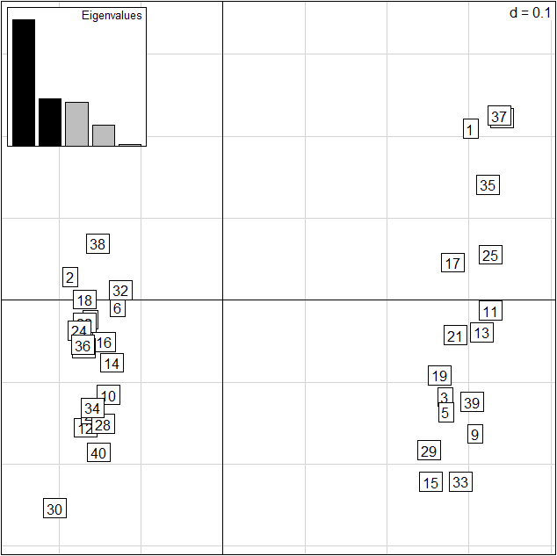
RLQ step 1 example (cont.)
Notes:
Ordination of R separates the open and forest habitats (axis1), axis2 is flower abundance/diversity. MarginType MarginPosition ForestProportion MarginArea FlowerDiversity FlowerAbundance are in

Slide 13
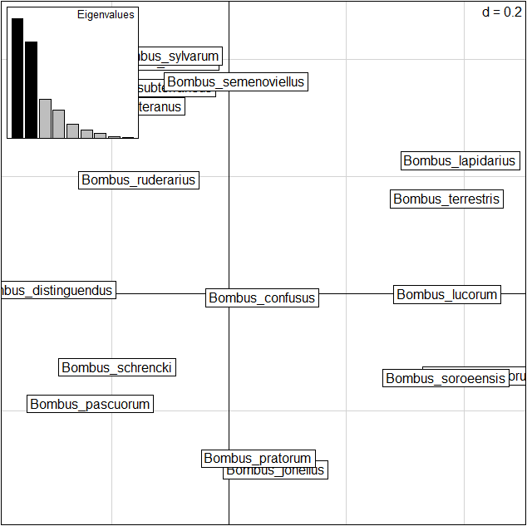
RLQ step 1 example (cont.)
Notes:
Ordination of Q (axis 1 colony size, axis 2 main habitat)

Slide 14
RLQ step 2
Now we make use of the 3 step 1 ordinations to produce a joint one
RLQ gives us a first axis with maximum covariance between the traits and the environmental variables (mediated by abundances)
Obviously we lose some information with the joint ordination (hopefully we gain more)
Notes:
Information is estimated during the process

Slide 15
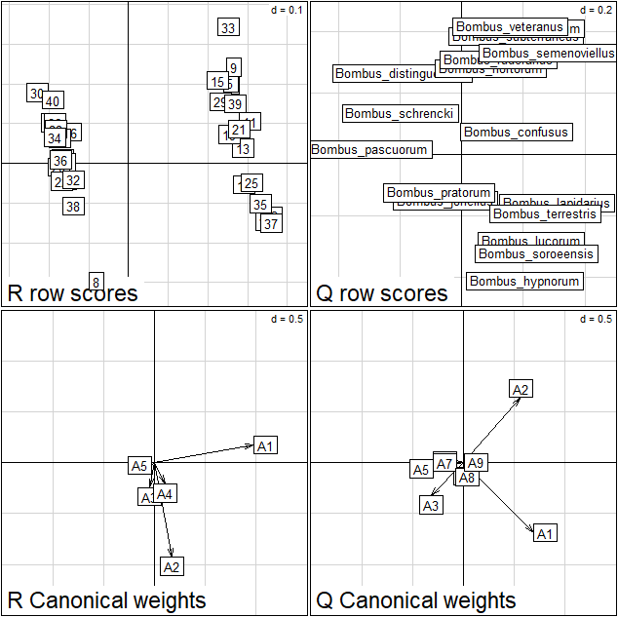
RLQ step 2 example (cont.)
Notes:
A1 on R is direction of open
A2 on R is direction of flower abundance
A1 on Q is direction of colony size
A2 ón Q is direction of habitat preference of open

Slide 16
Adding phylogeny and spatial location
Closely related species have probably more similar trait values than distantly related species
Spatially close sites are probably more similar than sites that are spatially distant
Adding those two aspects to the RLQ analysis leads to a phylogenetically and geographically informed ordination method
Pavoine, S., Vela, E., Gachet, S., De Bélair, G., & Bonsall, M. B. (2011). Linking patterns in phylogeny, traits, abiotic variables and space: a novel approach to linking environmental filtering and plant community assembly. Journal of Ecology, 99(1), 165-175.

Slide 17
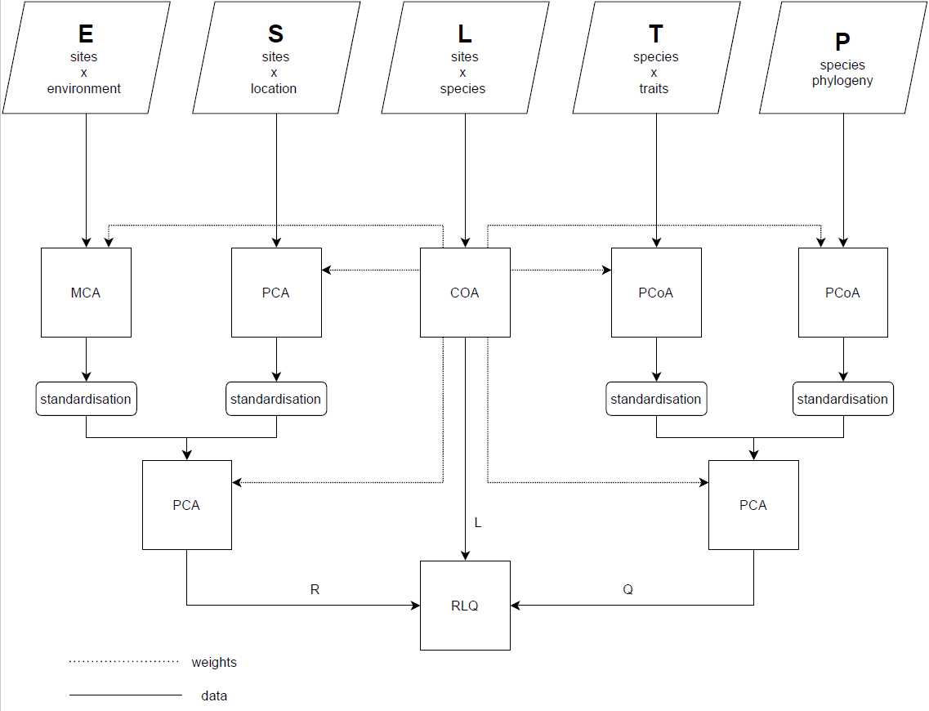
Adding phylogeny and spatial location
Notes:
Things look similar – now we start with 5 ordinations instead of 3 (step1). Combining E ja S and T ja P can be done in different manner (extra step) and in the end again RLQ

Slide 18
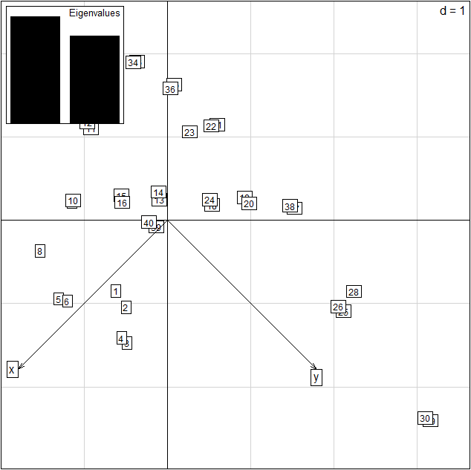
RLQ step 1 example (cont.)
Notes:
Pretty much what we expect (pairs of data)

Slide 19
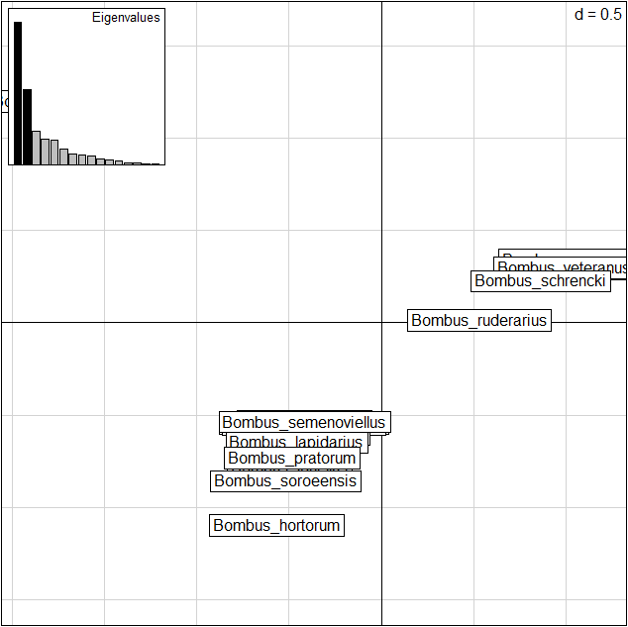
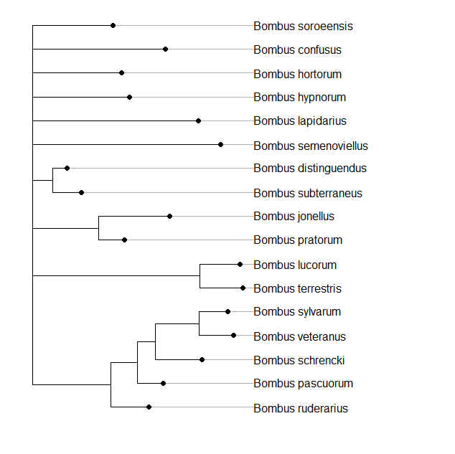
RLQ step 1 example (cont.)

Slide 20
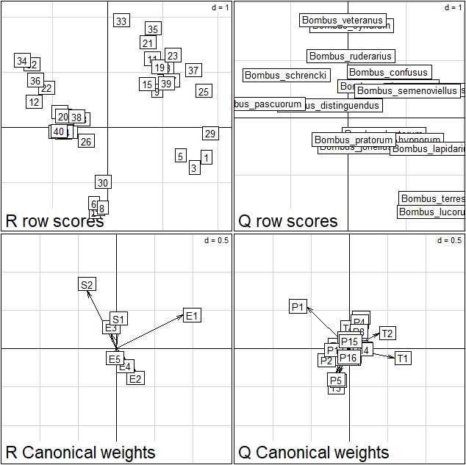
RLQ step 2 example (cont.)
Notes:
We still have same correspondence E1 with T2 and E2 with T1

Slide 21
Thank you!
Questions?

