Slide 1
Overdispersion and zero-inflation: best practices
V46 StatisticsCorner
Ants Kaasik
TARTU

Slide 2
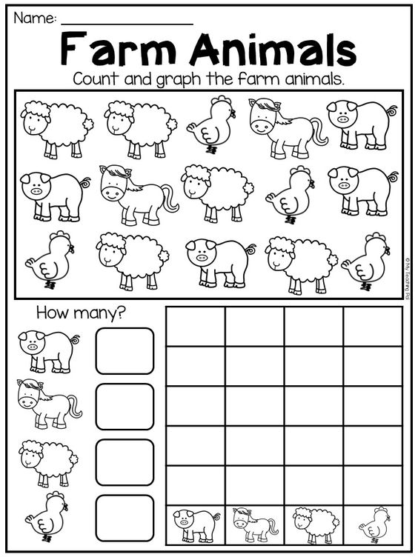
Starting point
We are looking at count data
Overdispersion can also occur for presence/absence data (when used in series)
Zero-inflation can also occur for continuous data
Source: https://www.pinterest.com/pin/402790760422312551

Slide 3
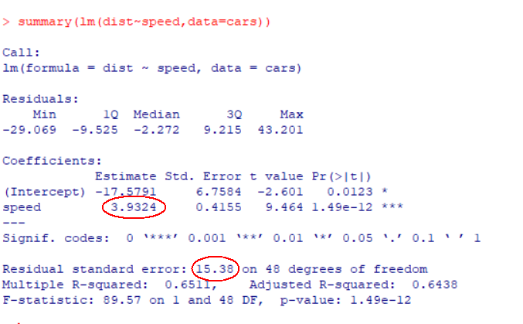
Basics 1: OLS
When we fit an ordinary (multiple) regression model then we estimate the mean (but also the variance)
Variance is not connected to the mean (Normal distribution has separate parameters for mean and variance)

Slide 4
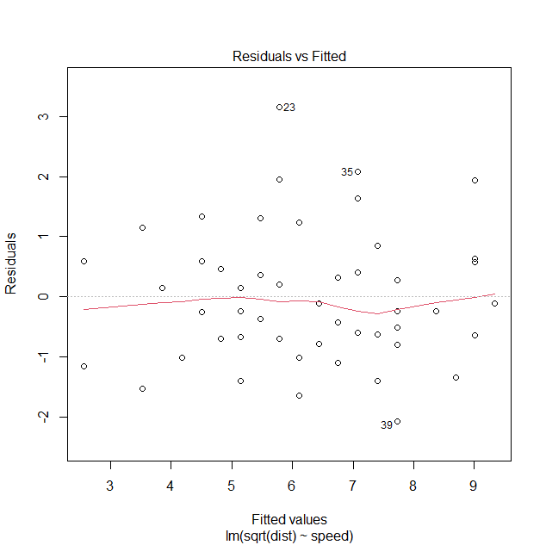
Basics 2: OLS visual
So we expect that the residual variation does not change with mean
And even when we have heteroskedasticity a transformation will usually normalize the residuals

Slide 5
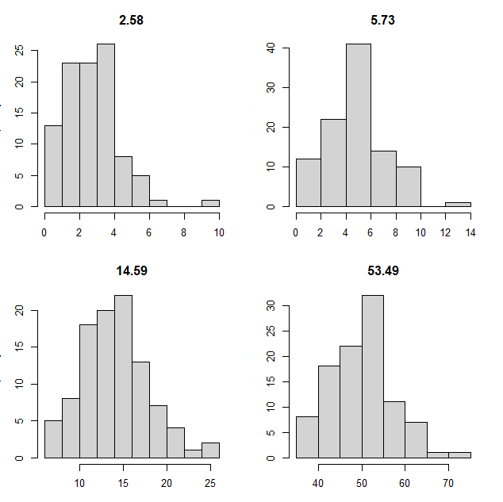
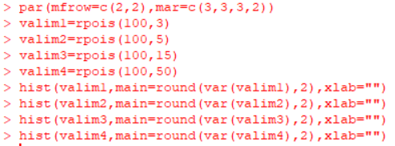
Basics 3: Poisson distribution
Poisson distribution only has 1 parameter so mean and variance both depend on it

Slide 6
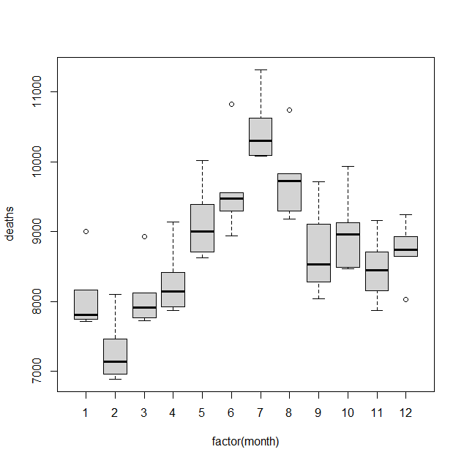
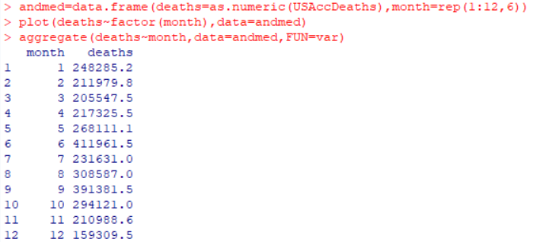
Detecting overdispersion
Sometimes overdispersion is obvious straight from the data

Slide 7
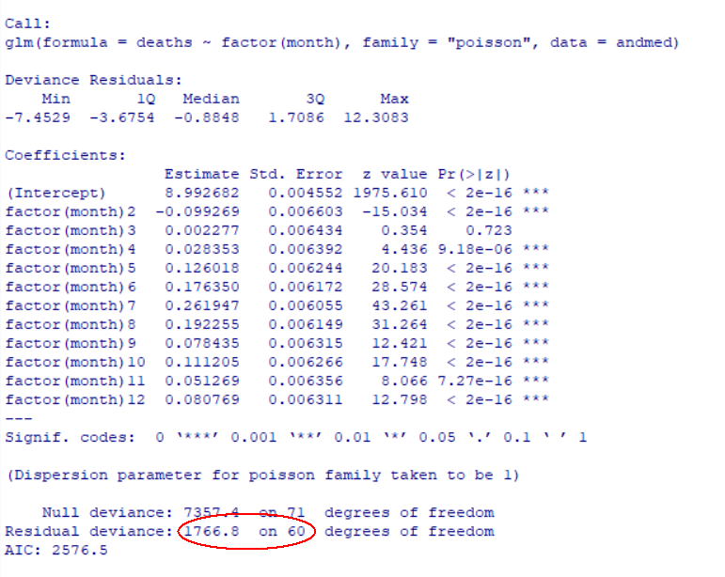
Detecting overdispersion (2)
Rule of thumb
Residual deviance divided by residual degrees of freedom should be approximately 1
Large ratio indicates overdispersion
Statistical tests are also an option

Slide 8
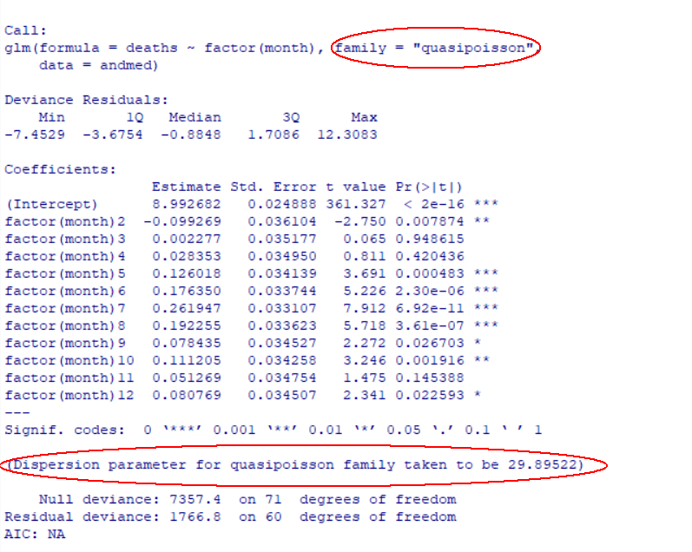
Correcting for overdispersion
Using a quasi family (e.g. quasipoisson) adds an extra variance parameter
Correcting for overdispersion is important because otherwise standard errors of the model parameters are underestimated (i.e. too small p-values will result)

Slide 9
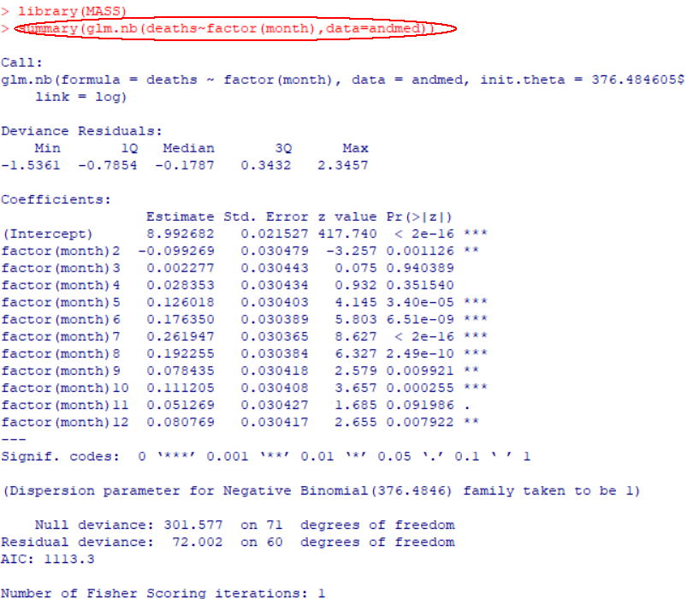
Correcting for overdispersion(2)
Alternative is using a discrete distribution suitable for modelling counts that already has two parameters.
Negative binomial distribution is a frequently used alternative

Slide 10
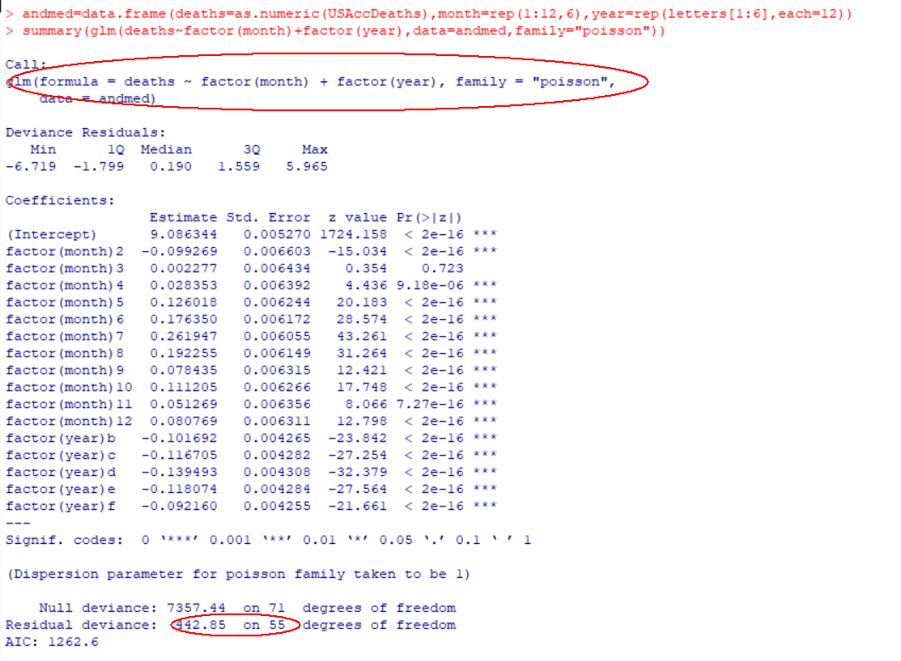
Why does overdispersion occur?
When some important predictors are missing or we have failed to specify the correct dependence structure for the data
Sometimes adding an observation level random effect is used (i.e. a random effect with a different value for each observation)

Slide 11
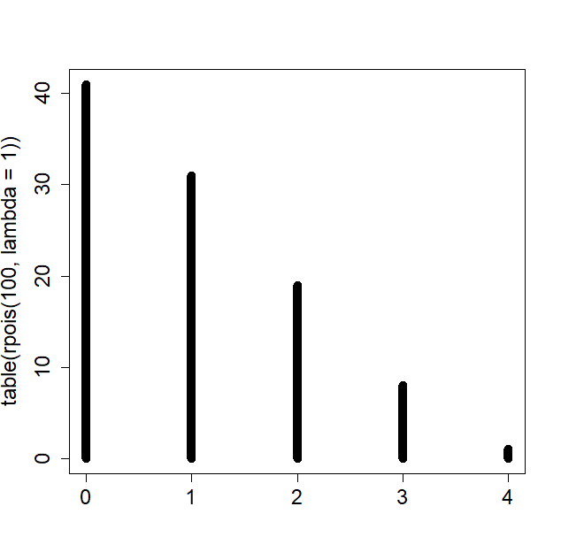
Recognizing zero-inflation
Typically, (proportionally) many zeroes in the dependent variable is a clear sign of zero-inflation.
But one has to keep in mind that for small values of the parameter, Poisson distribution does have a considerable probability of zero.

Slide 12
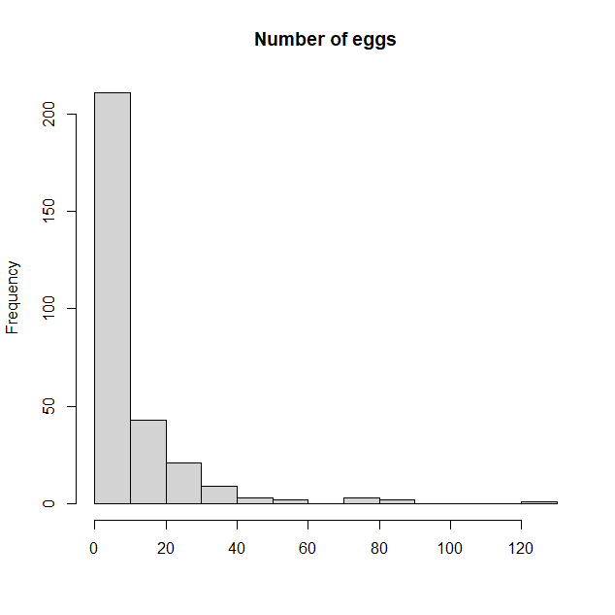
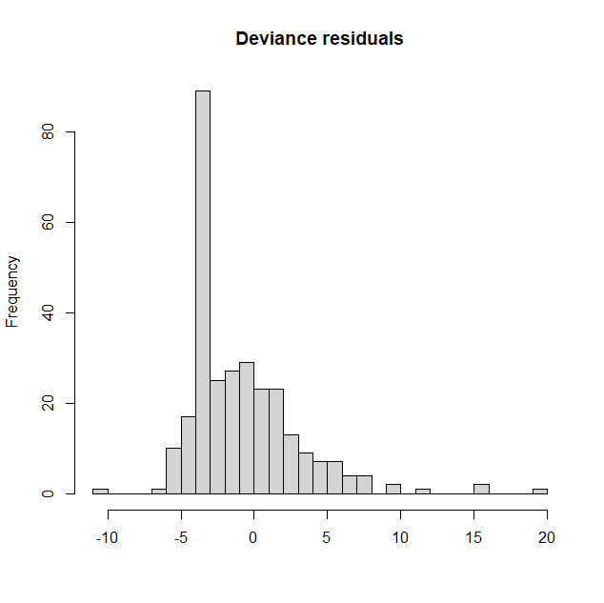
Recognizing zero-inflation (2)
Thus a good rule of thumb is that if there are many zeroes and the non-zero counts are not all small then we have zero-inflation.
But residual plot will typically provide the definitive answer.

Slide 13
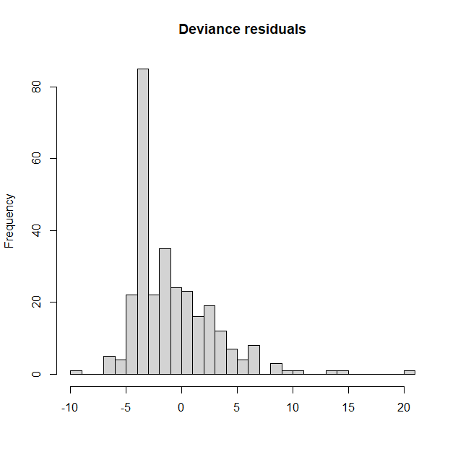
Testing zero-inflation
Different statistical tests are available. Vuong test (non-nested models) and the likelihood ratio test (nested models) are not actually correct here due to parameter on the boundary.
Clarke’s sign test should be correct but not implemented for GLMMs.

Slide 14
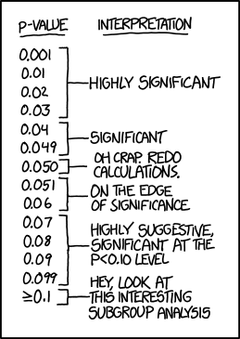
Testing zero-inflation (2)
Information criteria (AIC, BIC etc) can be used for model selection but again problematic with GLMMs.
It is always important to keep the selective inference problem („quiet scandal of statistics“) in mind…
Source: https://xkcd.com/1478/

Slide 15
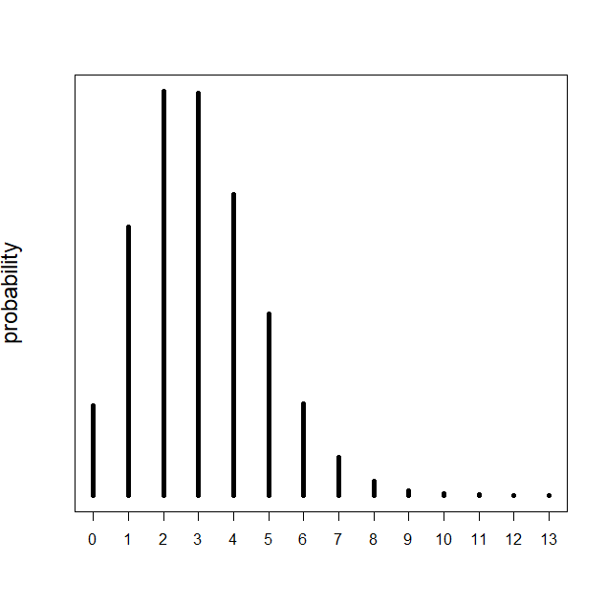
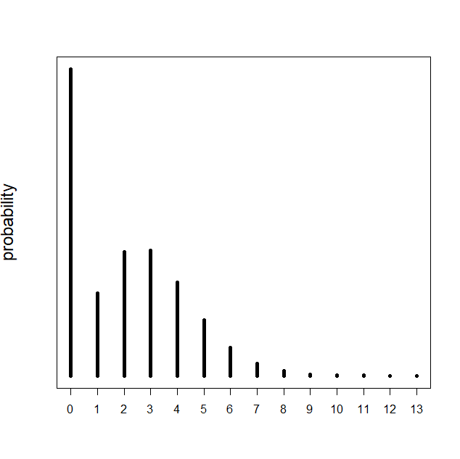
Allowing zero-inflation
Zero inflated models add probability mass to zero and re-normalize the rest of the probability density.
Hurdle models use a diferent approach – a zero-truncated distribution is used and probability mass is added to zero.

Slide 16
Allowing zero-inflation (2)
Package glmmTMB in R is a good tool for modelling when both zero-inflation and overdispersion is expected.
It has the syntax of package lme4, is fast and quite flexible.
m1=glmmTMB(Munade_hulk~scale(Õite_hulk)+(1|Kuupäev),
ziformula=~1,data=andmed,family="poisson")
Available distributions list is rich but for count data the alternatives to Poisson are negative binomial and the Conway-Maxwell-Poisson distribution (aka CMP aka compois). The latter allows both over- and underdispersion.

Slide 17
Allowing zero-inflation (3)
m1=glmmTMB(Munade_hulk~scale(Õite_hulk)+(1|Kuupäev),
ziformula=~1,data=andmed,family="poisson")
The zero-inflation parameter can also depend on covariates (i.e. zero inflation rate is not constant)
The package also allows for direct modelling of error variance (i.e. the variance around the mean is not only dependent on the mean but some other properties present in the data )

Slide 18
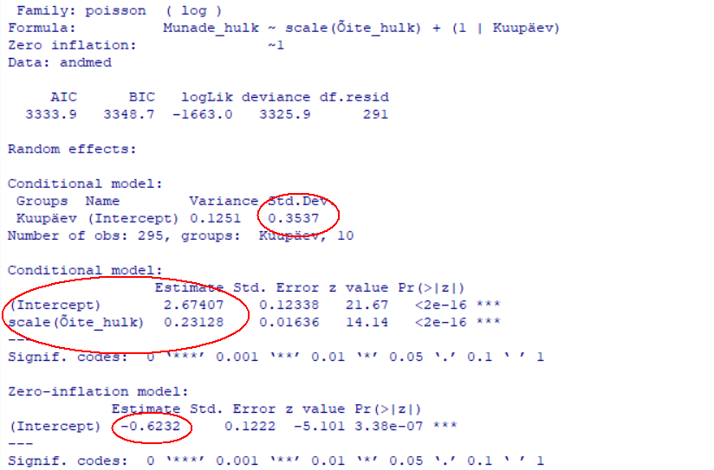
Allowing zero-inflation (4)
m1=glmmTMB(Munade_hulk~scale(Õite_hulk)+(1|Kuupäev),
ziformula=~1,data=andmed,family="poisson")

Slide 19
Allowing zero-inflation (5)
m1=glmmTMB(Munade_hulk~scale(Õite_hulk)+(1|Kuupäev),
ziformula=~1,data=andmed,family="poisson")

Slide 20
Practical problems
Zero-inflation can also cause overdispersion so testing for overdispersion first might not make sense
Zero-inflation can be assessed when we have fixed the distribution
Quiet scandal in statistics – when the model selection is based on the same data then using the selected model for inference is not the same as knowing the correct model and using it for inference

Slide 21
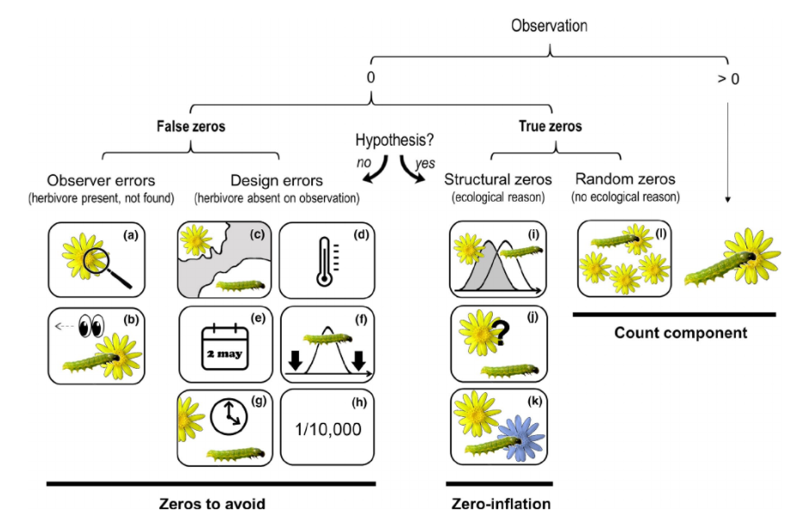
Practical problems (2)
Source: Blasco-Moreno et al.(2019), `What does a zero mean? understanding false, random and structural zeros in ecology', Methods in Ecology and Evolution.

Slide 22
Practical problems (2)
Source: Blasco-Moreno et al.(2019), `What does a zero mean? understanding false, random and structural zeros in ecology', Methods in Ecology and Evolution.

Slide 23
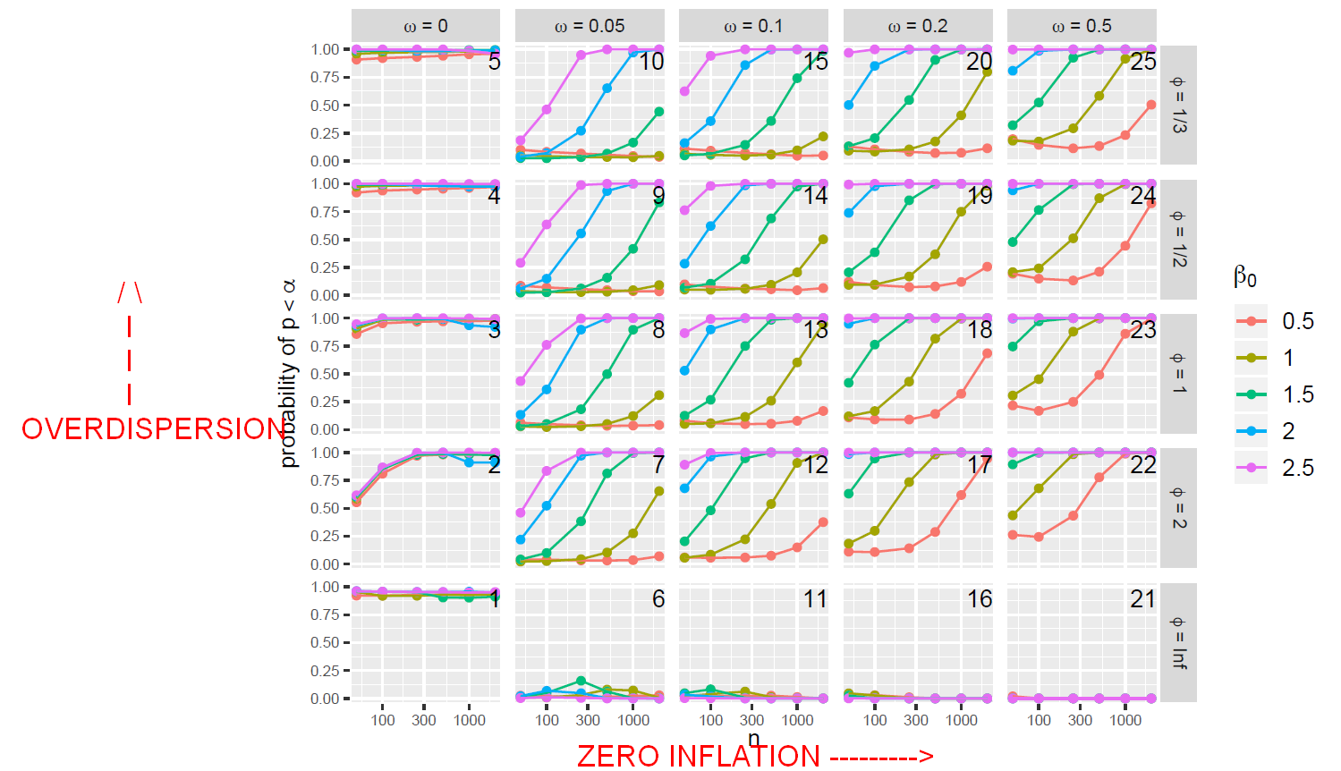
Q&A
Can we select the correct model with tests?
Source: Campbell, H., 2019. The consequences of checking for zero-inflation and overdispersion in the analysis of count data

Slide 24
Q&A (2)
Why not just calculate AIC for 4 different models (overdispersion x zero inflation combinations)?
This approach seems to perform worse in practice than sequential tests
Why not use a ZINB model all the time?
This model does not perform well when zero-inflation is actually not present in the data (typically low power)

Slide 25
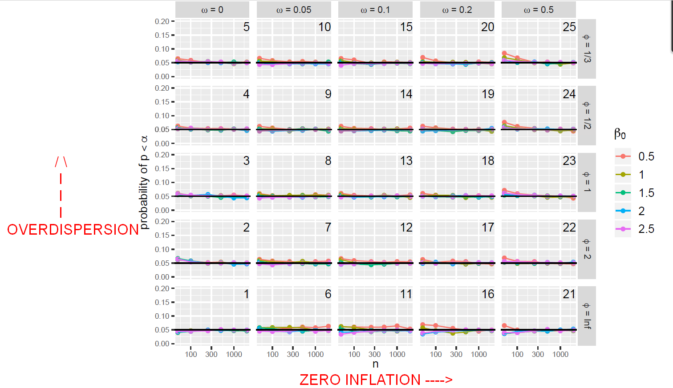
Q&A (3)
Is the quiet scandal scandalous in this case?
Source: Campbell, H., 2019. The consequences of checking for zero-inflation and overdispersion in the analysis of count data

Slide 26
Summary
When sample size is low then potential presence of zero-inflation and overdispersion will often cause us to select the wrong model when using the sequential testing scheme.
Model selection (among the 4 overdispersion x zero inflation combinations)using AIC will be more successful in identifying the correct model but paradoxically the type I errors are more frequent (i.e when we use AIC for model selection we actually get false significance of predictors more often than when using the sequential testing instead of AIC)
Overall the situation is not that bad.
When using a ZINB model we have lower power but we are more protected from false significance.

Slide 27
Thank you for the attention!

