Slide 1
HMSC: linking patterns in phylogeny, traits, environment and space
L2 StatisticsCorner
Ants Kaasik

Slide 2
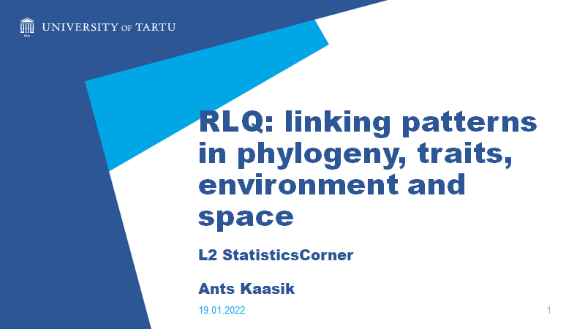
Remember?
RLQ is mostly and ordination technique
"Ordination is the collective term for multivariate techniques that arrange sites along axes on the basis of data on species composition" (ter Braak 1987)
" The displaying of a swarm of data points in a two or threedimensional coordinate frame so as to make the relationships among the points in many-dimensional space visible on inspection" (Pielou 1984)
Palmer M (2017). Ordination Methods for Ecologists (http://ordination.okstate.edu), visited 13.01.2022
Notes:
Basically, look our data with new coordinates but so that this visual is somehow informative

Slide 3
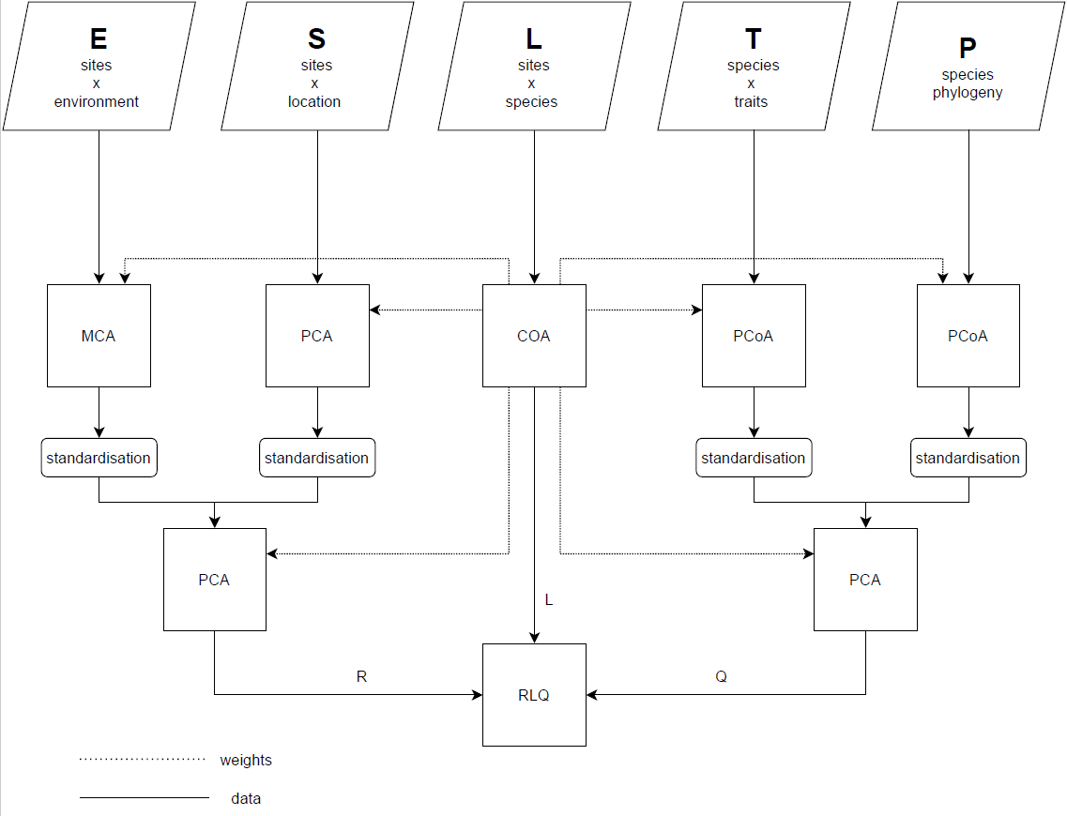
Adding phylogeny and spatial location
Notes:
Things look similar – now we start with 5 ordinations instead of 3 (step1). Combining E ja S and T ja P can be done in different manner (extra step) and in the end again RLQ

Slide 4
However…
RLQ (and the closely realted fourth corner analysis) also allows us perform permuation tests to test for the presence of associations between
e.g. Enviromental variables and species traits;
Phylogeny and spatial layout;
etc
Notes:
Basically, look our data with new coordinates but so that this visual is somehow informative

Slide 5
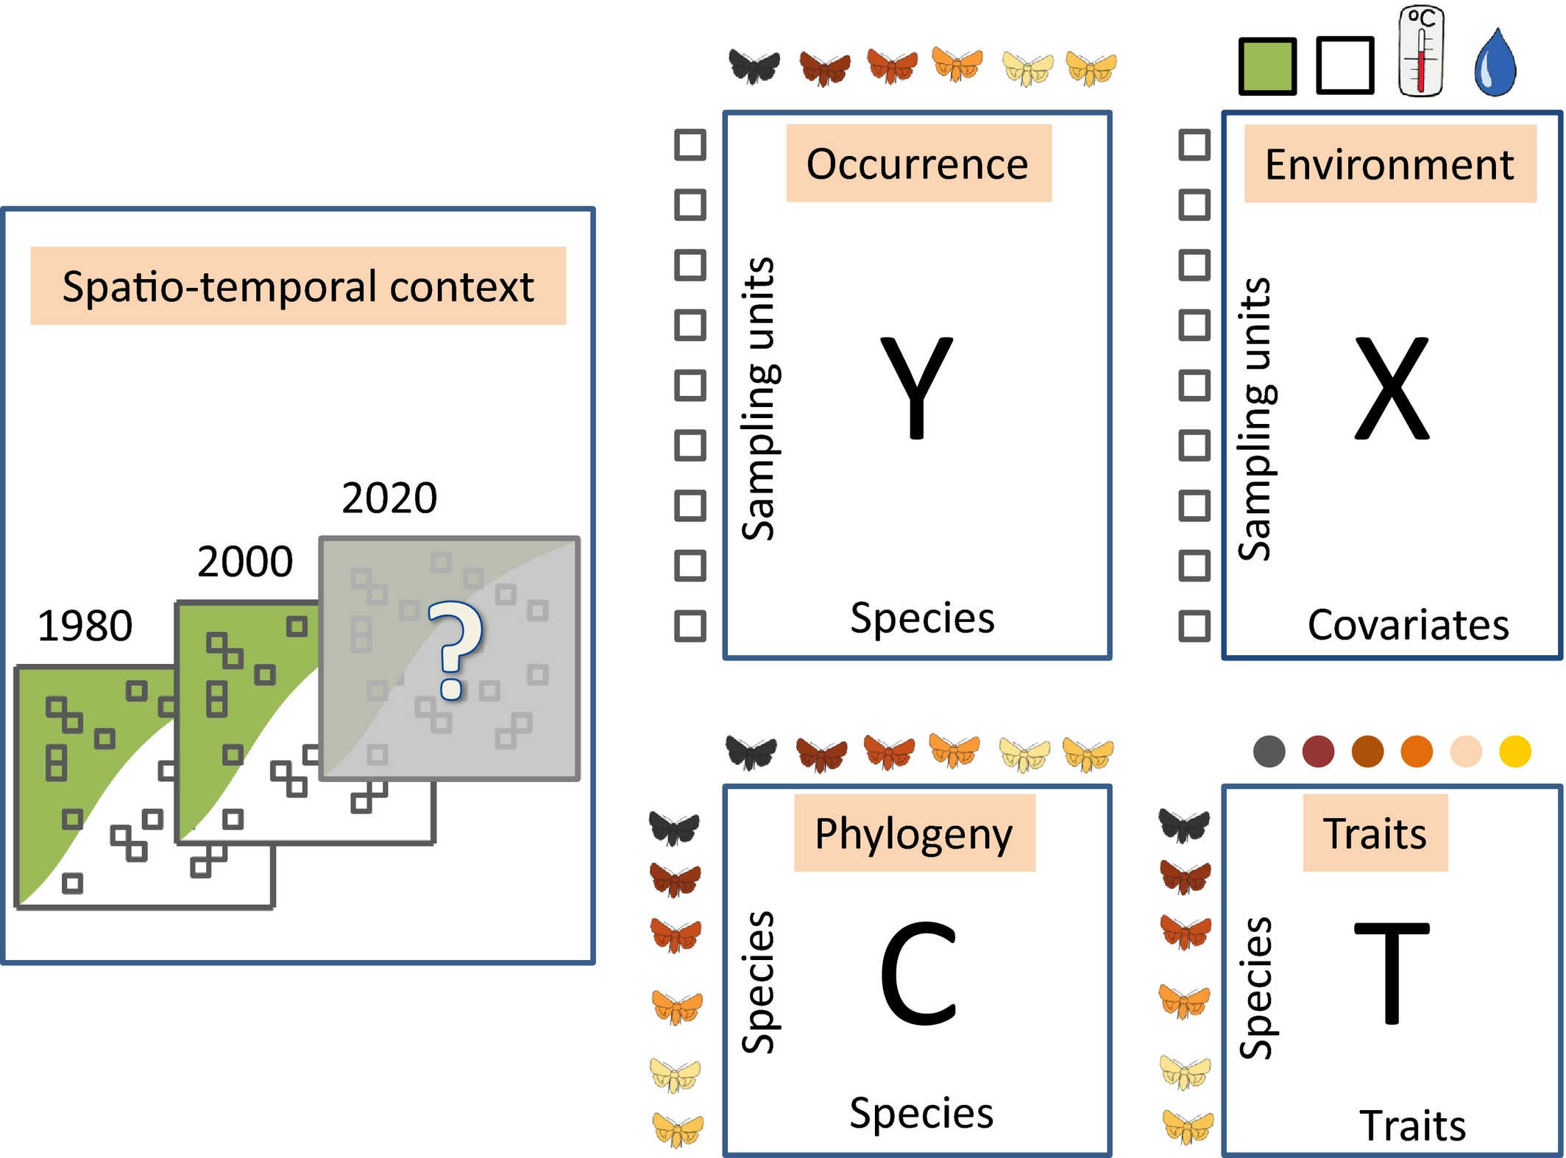
Then what about…
Ovaskainen et al. Ecology Letters, Volume: 20, Issue: 5, Pages: 561-576, First published: 20 March 2017, DOI: (10.1111/ele.12757)
Notes:
Data typically collected in community ecology. The occurrence data (denoted as the Y matrix) includes the occurrences of the species recorded in a set of temporal and/or spatial sampling units. The environmental data (denoted as the X matrix) consists of the environmental covariates measured over the sampling units. The traits data (denoted as the T matrix) consists of a set of traits measured for the species present in the Y matrix. To account for the phylogenetic dependencies among the species, we can include a fourth matrix consisting of the phylogenetic correlations among the species (denoted as the C matrix). The spatiotemporal context includes location and time information about the samples.
IF THIS IMAGE HAS BEEN PROVIDED BY OR IS OWNED BY A THIRD PARTY, AS INDICATED IN THE CAPTION LINE, THEN FURTHER PERMISSION MAY BE NEEDED BEFORE ANY FURTHER USE. PLEASE CONTACT WILEY'S PERMISSIONS DEPARTMENT ON PERMISSIONS@WILEY.COM OR USE THE RIGHTSLINK SERVICE BY CLICKING ON THE 'REQUEST PERMISSIONS' LINK ACCOMPANYING THIS ARTICLE. WILEY OR AUTHOR OWNED IMAGES MAY BE USED FOR NON-COMMERCIAL PURPOSES, SUBJECT TO PROPER CITATION OF THE ARTICLE, AUTHOR, AND PUBLISHER.

Slide 6
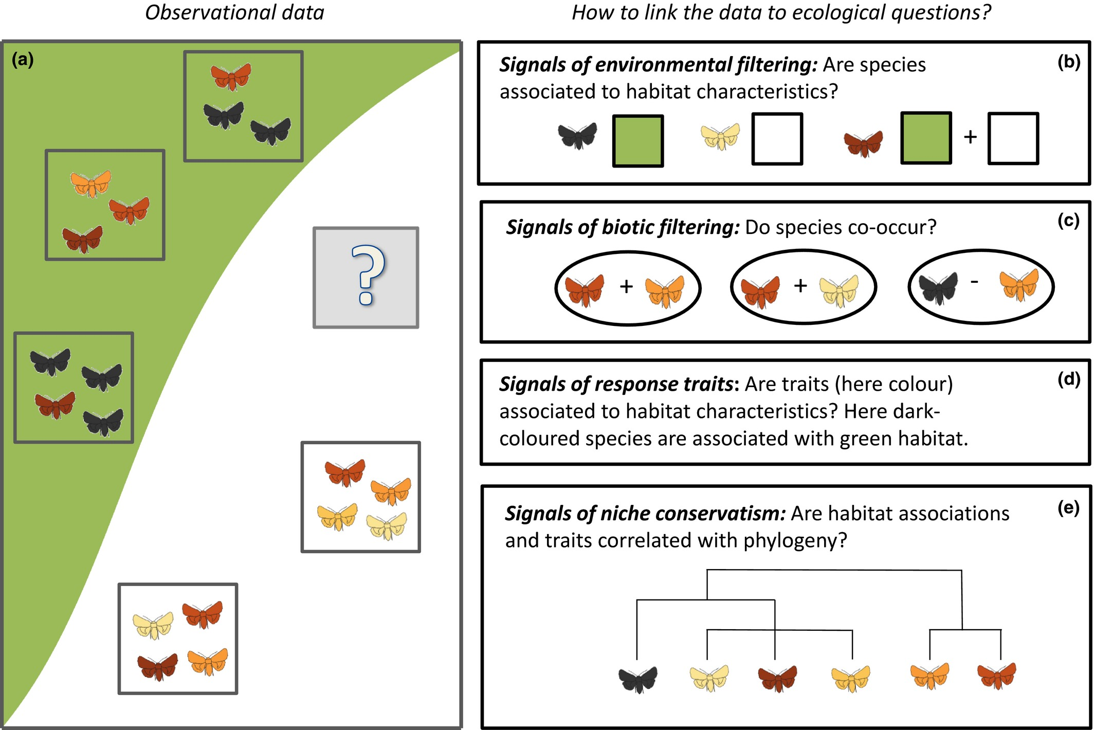
How to make more out of community data? A conceptual framework and its implementation as models and software
Ecology Letters, Volume: 20, Issue: 5, Pages: 561-576, First published: 20 March 2017, DOI: (10.1111/ele.12757)
Notes:
A conceptual illustration of some key questions in community ecology. The green and white colours represent differences in the environmental conditions, the butterflies with different colours represent different species, and the small boxes represent sampling units. In this paper, we ask how species occurrence data (a) can be used to understand how the processes depicted in Fig. structure the community under study, and how one can predict communities under new conditions (the sampling unit with question mark). In terms of species niches and environmental filtering (b), the black‐coloured species only occurs under green environmental conditions and the lightest‐coloured species under white environmental conditions, whereas the red coloured species occurs under both kind of environmental conditions. In terms of biotic interactions (c), some species pairs are found to co‐occur more or less often by random. However, part of this variation can be explained simply by habitat associations, whereas in some cases there is non‐random co‐occurrence also beyond that explained by habitat association. In this example, the black‐coloured species appears to dominate the local communities when present, indicating that it may be a competitively superior species. In terms of response traits, species colour appears to co‐vary with environmental conditions, with the dark‐coloured species being associated with the green habitat and the light‐coloured species with the white habitat (d). As colour does not appear to be phylogenetically structured (e), the species provide essentially independent data points about the influence of colour on occurrence, suggesting an adaptive response rather than an artefact due to phylogenetic constraints.
IF THIS IMAGE HAS BEEN PROVIDED BY OR IS OWNED BY A THIRD PARTY, AS INDICATED IN THE CAPTION LINE, THEN FURTHER PERMISSION MAY BE NEEDED BEFORE ANY FURTHER USE. PLEASE CONTACT WILEY'S PERMISSIONS DEPARTMENT ON PERMISSIONS@WILEY.COM OR USE THE RIGHTSLINK SERVICE BY CLICKING ON THE 'REQUEST PERMISSIONS' LINK ACCOMPANYING THIS ARTICLE. WILEY OR AUTHOR OWNED IMAGES MAY BE USED FOR NON-COMMERCIAL PURPOSES, SUBJECT TO PROPER CITATION OF THE ARTICLE, AUTHOR, AND PUBLISHER.

Slide 7
What is the difference?
HMSC is a more complicated framework
Basically it is a multivariate generalized linear mixed model fitted with Bayesian machinery
Technically then perhaps less of a black box than RLQ but in practice this might not be so (e.g. undetected convergence problems)
Notes:
PCA, of the varespec dataset (from package vegan). Sites x Species dataset with coverage % as the measured variable. Species as arrows and sites as numbers

Slide 8
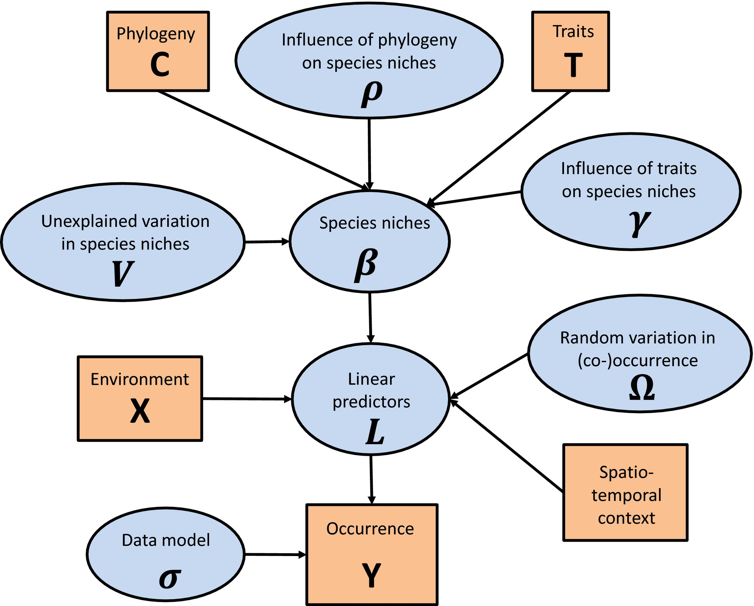
Ecology Letters, Volume: 20, Issue: 5, Pages: 561-576, First published: 20 March 2017, DOI: (10.1111/ele.12757)
Notes:
A graphical summary of the HMSC statistical framework. In this Directed Acyclic Graph (DAG), the orange boxes refer to data, the blue ellipses to parameters to be estimated, and the arrows to functional relationships described with the help of statistical distributions.
IF THIS IMAGE HAS BEEN PROVIDED BY OR IS OWNED BY A THIRD PARTY, AS INDICATED IN THE CAPTION LINE, THEN FURTHER PERMISSION MAY BE NEEDED BEFORE ANY FURTHER USE. PLEASE CONTACT WILEY'S PERMISSIONS DEPARTMENT ON PERMISSIONS@WILEY.COM OR USE THE RIGHTSLINK SERVICE BY CLICKING ON THE 'REQUEST PERMISSIONS' LINK ACCOMPANYING THIS ARTICLE. WILEY OR AUTHOR OWNED IMAGES MAY BE USED FOR NON-COMMERCIAL PURPOSES, SUBJECT TO PROPER CITATION OF THE ARTICLE, AUTHOR, AND PUBLISHER.

Slide 9
HMSC example (1)

Slide 10
HMSC example (2)

Slide 11
HMSC example (3)

Slide 12
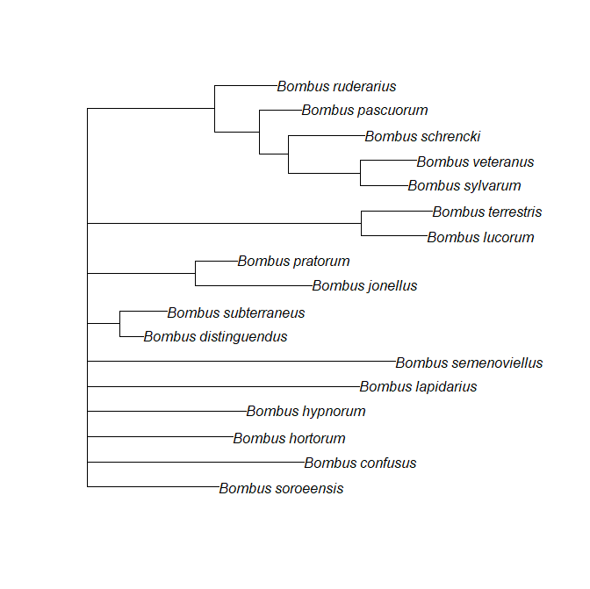
Bumblebees revisited (1)

Slide 13
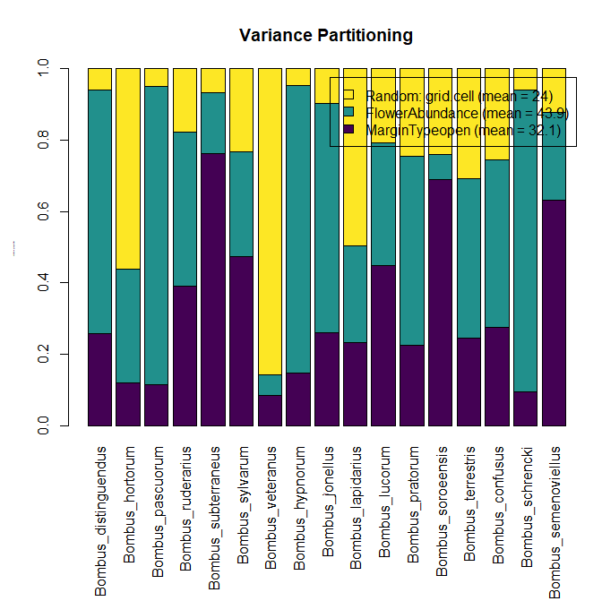
Bumblebees revisited (2)
Notes:
RLQ 1 minute, this model 50 minutes and still mentions of longer chains needed

Slide 14
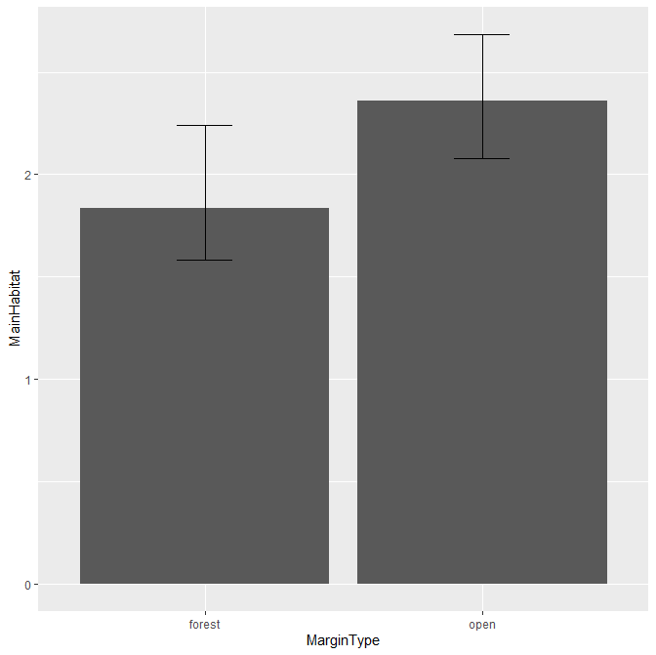
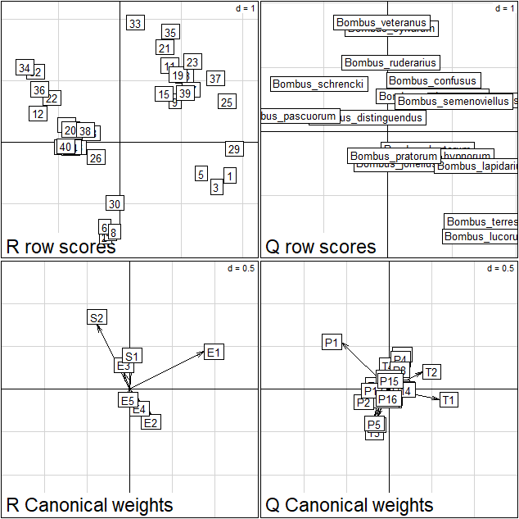
Bumblebees revisited (3)
Notes:
Left hmsc, right phyloRLQ. E1 is direction of Margintype=open and T2 is direction on Mainhabitat=open (also on hmsc plot larger values of main habitat refer to open)

Slide 15
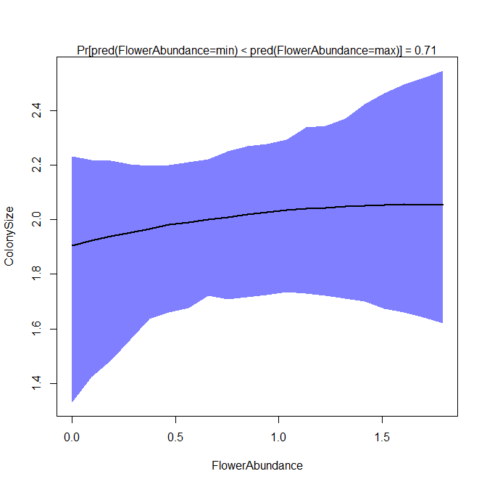
Bumblebees revisited (4)
Notes:
Left hmsc, right phyloRLQ. E2 is direction of Flowerabundance and T1 is direction of Colonysize (also on hmsc plot larger values of Colony size refer to larger Colony size)

Slide 16
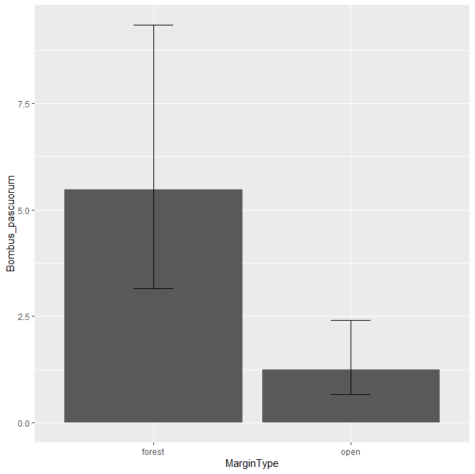
Bumblebees revisited (5)
Notes:
Left hmsc, right phyloRLQ. E1 is direction of Margintype=open and T2 is direction on Mainhabitat=open (also on hmsc plot larger values of main habitat refer to open). Pascuorum likes margintype forest also according to RLQ (left side)

Slide 17
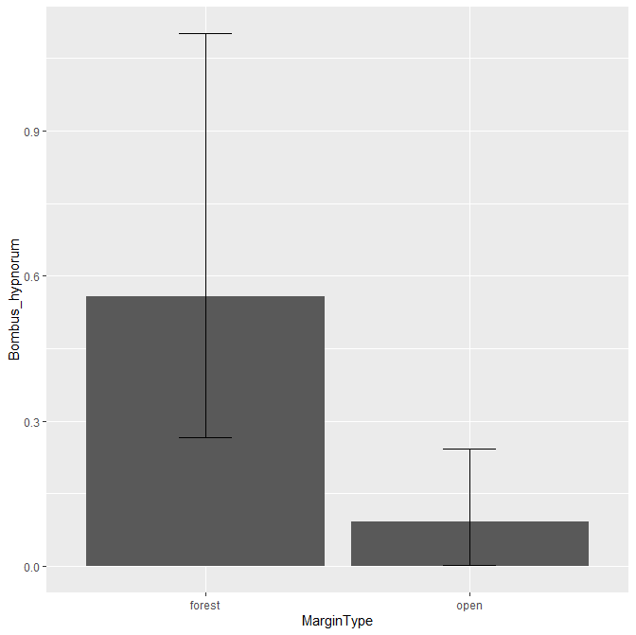
Bumblebees revisited (6)
Notes:
Left hmsc, right phyloRLQ. E1 is direction of Margintype=open and T2 is direction on Mainhabitat=open (also on hmsc plot larger values of main habitat refer to open). Hypnorum is dead center according to RLQ.

Slide 18
What is the difference?
1) Time
2) Hmsc allows for more complicated relationships
3) Hmsc directly allows for hierarchical structure of the data
4) Hmsc allows for more statistical tests (but also assumes a lot)

Slide 19
Thank you!
Questions?

