Slide 1
Bayesian statistics with Stan and brms
V46 StatisticsCorner
Ants Kaasik

Slide 2
My aim
You know Bayesian inference exists.
After the presentation you will also know that it is (now) completely feasible and if your research should include it then you know where to start.
When reviewing a paper/watching a presentation you know what to look for and how to comprehend things.

Slide 3
Bayesian?
In addition to the usual model choice (e.g. binomial glm, linear mixed model) we also give prior distributions to model parameters.
This allows us to get as a result posterior distributions of the model parameters (i.e. level of plausible variation is already included in the result).
Notes:
This variation thing is important because the world of science is (slowly) moving from simple p-value testing to quantifying variation in data.

Slide 4
Too good to be true?
Typically the posterior cannot be worked out analytically and one has to simulate from it but this can’t be done directly but using Markov Chain Monte Carlo (MCMC; a simulation process that converges to the desired distribution).
This means that potentially the convergence can be slow and the whole process very time-consuming (but also lets not compare apples and oranges).
Notes:
Yes, it can take weeks. But also we are not using approximations. If we do not use asymptotic theory in our usual frequentist stats (and produce likelihood based CIs) then this can also be super-slow. Conversely, if we use the approximations in Bayesian inference then we can also proceed faster.

Slide 5
Niche no more
Developments in Hamiltonian Monte Carlo (HMC; a clever approach to make the convergence more rapid) mean that even models with large number of parameters can now be „fitted“ fairly rapidly.
Specialized software Stan can be used to use HMC but R package brms allows to use Stan indirectly using R modelling language. Many of the most often used models are available.
Notes:
Stan was (somewhat) complicated. Brms is not. If you can use lme4 then you can use brms.

Slide 6
From the author
A wide range of distributions and link functions are supported, allowing users to fit – among others – linear, robust linear, binomial, Poisson, survival, response times, ordinal, quantile, zero-inflated, hurdle, and even non-linear models all in a multilevel context.
Further modeling options include autocorrelation of the response variable, user defined covariance structures, censored data, as well as meta-analytic standard errors.
Bürkner PC (2017). “brms: An R Package for Bayesian Multilevel Models using Stan.” Journal of Statistical Software, 80(1), 1–28
Notes:
Things are added all the time.

Slide 7
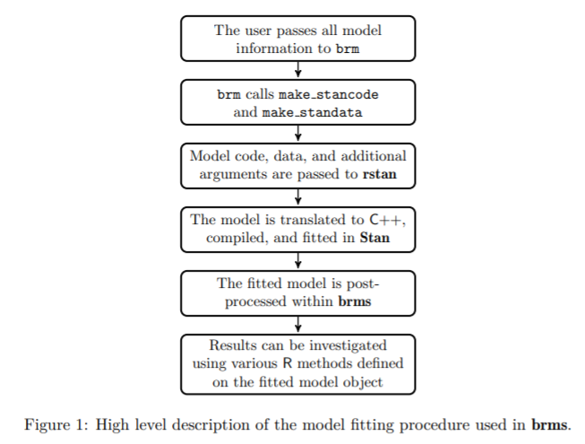
How does brms work?
Bürkner PC (2017). “brms: An R Package for Bayesian Multilevel Models using Stan.” Journal of Statistical Software, 80(1), 1–28
Notes:
So basically brms is just a frontend

Slide 8
How do I work with brms?
library(MASS)
head(cabbages)
Cult Date HeadWt VitC
1 c39 d16 2.5 51
2 c39 d16 2.2 55
3 c39 d16 3.1 45
4 c39 d16 4.3 42
5 c39 d16 2.5 53
6 c39 d16 4.3 50
Notes:
Two species and 3 dates

Slide 9
How do I work with brms? (2)
fit1 <- brm(formula = VitC~Cult*Date, data=cabbages, family = gaussian())
summary(fit1)
Notes:
Model compilation takes 30 seconds, simulation is probably 10 seconds. Rhat, Bulk_ESS, Tail_ESS

Slide 10
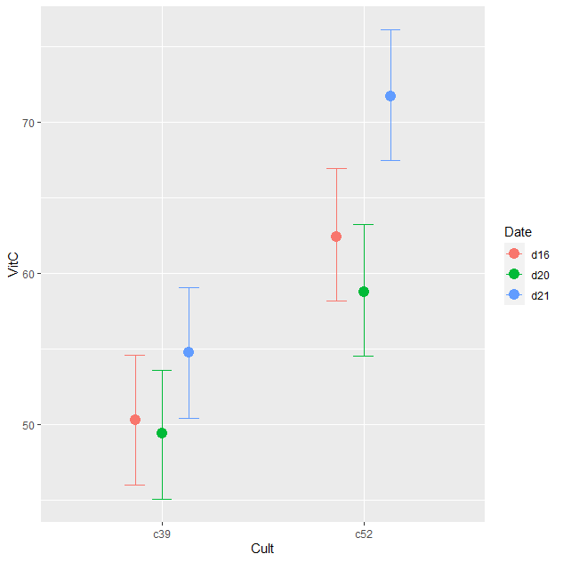
How do I work with brms? (3)
conditional_effects(fit1)

Slide 11
How do I work with brms? (4)
fit2 <- update(fit1, formula. = ~ . - Cult:Date)
LOO(fit1,fit2)

Slide 12
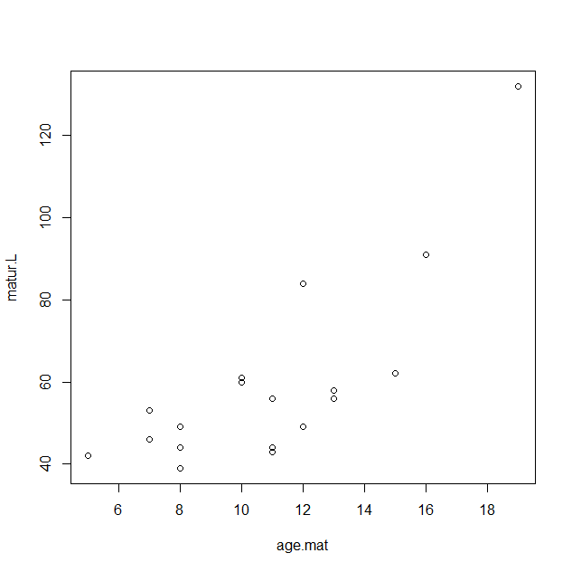
How do I work with brms? (5)
library(ade4)
data(lizards)
plot(matur.L~age.mat,
data=lizards$traits)

Slide 13
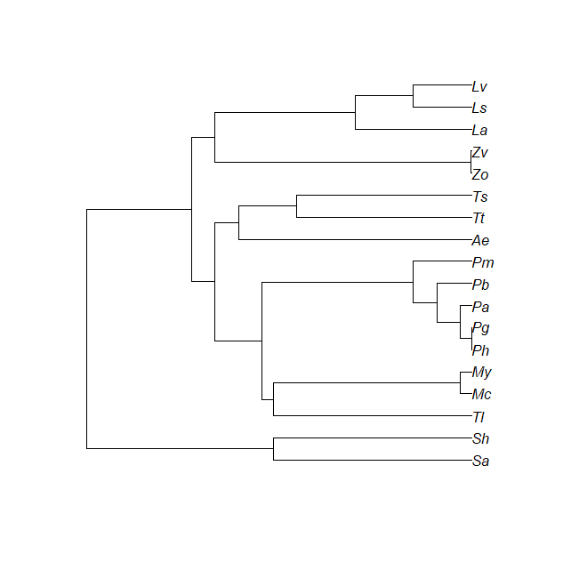
How do I work with brms? (6)
library(ape)
puu <- read.tree(text=lizards$hprA)
covmat <- ape::vcv.phylo(puu)
lizards$traits$species <-rownames(lizards$traits)

Slide 14
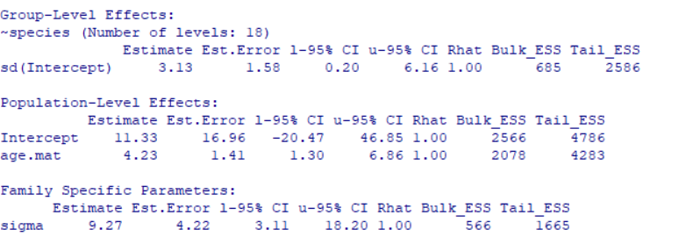
How do I work with brms? (7)
fit3 <- brm(matur.L ~ age.mat + (1|gr(species, cov = A)), data = lizards$traits, family = gaussian(), data2 = list(A = covmat), iter = 5000, warmup = 2000, control=list(adapt_delta=0.9995, max_treedepth=20))
Notes:
We need to take smaller steps and thus more steps if the posterior is more complicated.

Slide 15
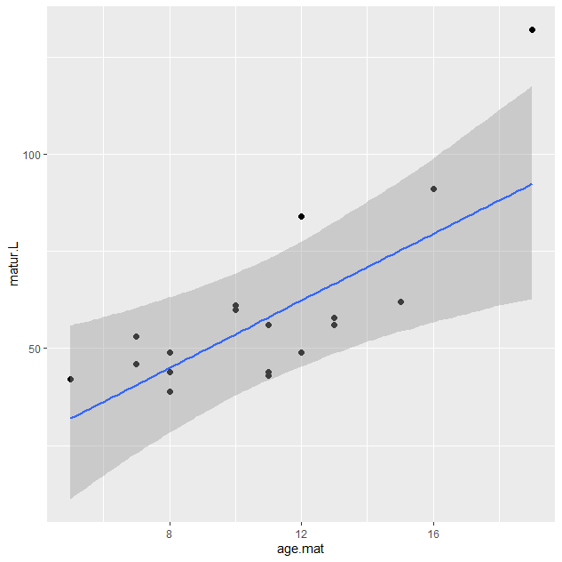
How do I work with brms? (8)
plot(conditional_effects(fit3), points=T)

Slide 16
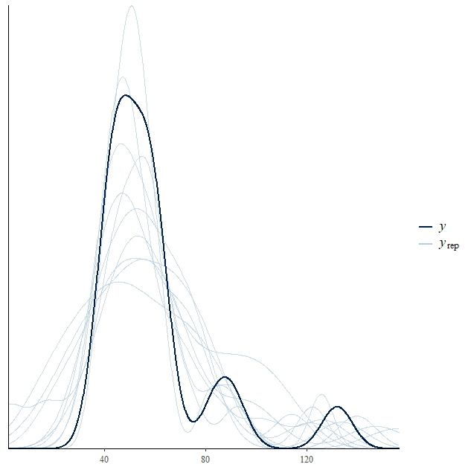
Why should I work with brms?
We can fit some models that we would not be easily able to fit otherwise (e.g. phylogenetic GLMM).
We can easily do posterior predictive checks to assess the model.
Notes:
If you worry about priors affecting results then it is very easy to do a sensitivity analysis.

Slide 17
Pre-requirements
See here: https://github.com/stan-dev/rstan/wiki/RStan-Getting-Started
Nothing too complicated but some steps are also outside R environment.
Final step is the installation of package brms in R.

Slide 18
Useful links/searches
Stancon 2018 & 2020 (youtube)
Bayesian workflow (https://arxiv.org/pdf/2011.01808.pdf)
Generable (youtube channel)
Learning Bayesian Statistics (podcast)
Bayesian Data Analysis course (https://github.com/avehtari/BDA_course_Aalto)
BDA3 book (http://www.stat.columbia.edu/~gelman/book/)
Statistical rethinking course (youtube)
Statistical rethinking with brms (https://bookdown.org/content/4857/)

Slide 19
Thank you!
Questions?

